Slide 1

ADULT
Health Survey

Slide 2
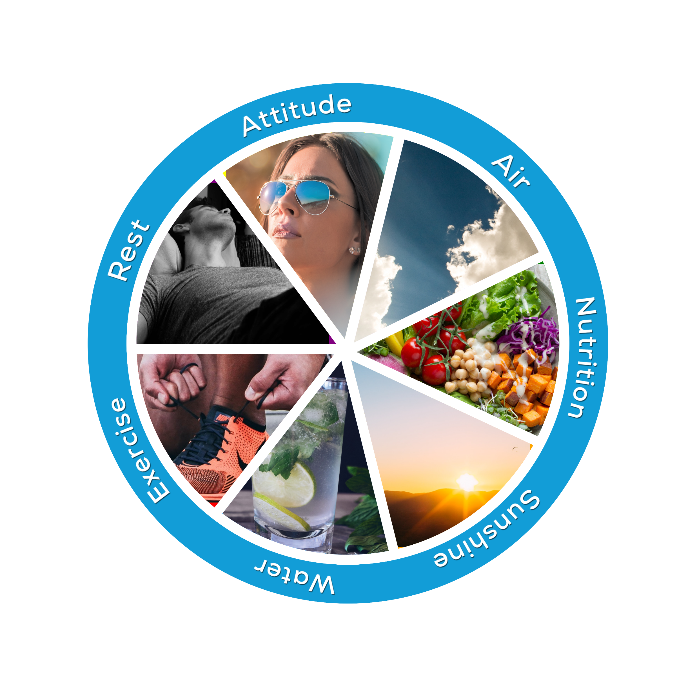
Hi,
Welcome to the It Takes 7 Health Survey!
7 Easy Steps
Print the Health Survey Results sheet.
Complete the Health Survey questions. Tally and colour in your results as you go.
Review your results. Share and compare.
Research the healthcare practices you need to address.
Formulate and make a record of how you plan to improve your healthcare practices. Chart your progress.
Redo the survey in a month.
Remember…..Take care naturally!

Slide 3
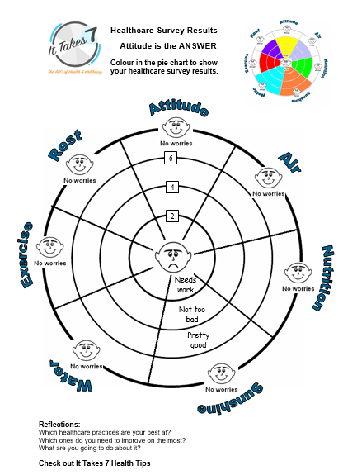

1. Print a copy of this Health Survey Results Sheet before you start the survey.
2. Answer the health survey questions on the following slides. Tally your results and colour in the sections on your Health Survey Result’s sheet to match your score.

Slide 4

ATTITUDE
Are your emotions well balanced?
Are your motivation levels high?
Do you get on well with family and friends?
Work associates?
Do you manage conflict situations effectively?
Do you enjoy your own company?
Are you often happy or content?
Do you read inspirational stories regularly?
Yes = +1 No = -1 Unsure or in between = 0

Slide 5
AIR
Do you breathe through your nose?
Do you regularly breathe deeply?
Do you use breathing to calm your emotions?
Is your posture generally upright and chest expanded?
Do you open windows/doors to let fresh air in the house?
Do you live in a smoke-free home?
Do you have potted plants in your house?
Do you go outside and enjoy fresh air daily?
Yes +1 No = -1 Unsure or in between = 0

Slide 6
NUTRITION
Do you eat 3 meals each day?
Do you eat at least 2 fruit and 5 vegetables each day?
Do you eat protein with each meal? (meats, fish, dairy, nuts, legumes)
Do you avoid fatty, over salted foods?
Do you drink limited tea, coffee, alcohol or caffeinated drinks daily?
Do you limit daily sweet treats or soft drinks to one a day?
Do you eat your meal in a relaxed manner?
Do you take a moment to give thanks for your meal?
Yes = +1 No = -1 Unsure or in between = 0

Slide 7
SUNSHINE
In the Summer do you regularly practice SunSmart rules? (hat, sunscreen, protective clothing, sunglasses, water)
Do reapply sunscreen when in the sun for lengthy periods?
Do you cover up during maximum sun times (10am -3pm)?
Do you spend time outdoors during the safe sun times? (Early in the morning or late afternoon)
In the winter do you get adequate exposure to sunlight?
Do you understand the role of Vitamin D in the body?
Do you make efforts to seek sunshine to enhance your mood?
Do you know exposure to the sun is important for gut health?
Yes = +1 No = -1 Unsure or in between = 0

Slide 8
WATER
Do you drink water regularly throughout the day?
Do you drink 1½ - 2 litres of water daily?
Do you drink filtered or rainwater?
Do you increase your intake of water when in heated or air-conditioned rooms?
Do you drink more water when exercising?
Do you dilute your fruit juices or sugary drinks?
Do you avoid drinking more than 2 caffeinated drinks a day?
Do you regularly carry a water bottle?
Yes = +1 No = -1 Unsure or in between = 0

Slide 9
EXERCISE
1. Do you exercise regularly?
2. Is being active a part of your daily routine?
3. Do you walk or ride instead of taking the car or public transport?
4. Do you engage in team sport activities?
5. On your holidays do you seek out physical recreational activities?
(hiking, swimming, cycling, etc)
6. Do you have a gym membership or exercise with a friend?
7. Do you enjoy physical exercise?
8. Do you set exercise goals and stick to them?
Yes = +1 No = -1 Unsure or in between = 0

Slide 10
REST
Do you sleep deeply?
Do get a minimum of 6-8 hrs sleep a night or 10 hrs if you are a teenager or elderly?
Do you rarely/never use drugs or alcohol to help you sleep?
Do you engage in other activities to help you relax?
Do you power-nap, meditate or pray to unwind?
Do you avoid using technology late at night?
Do you take annual vacations?
Do you consciously relax your body?
Yes = +1 No = -1 Unsure or in between = 0
Blue wave design credit: <a href="https://www.freepik.es/fotos-vectores-gratis/fondo">Vector de Fondo creado por Creative_hat - www.freepik.es</a>

Slide 11
Nearly there!
3. Consider which of your healthcare practices need
work. Share your results with a partner.
4. Research the healthcare practices you need to
address. Check out It Takes 7 Health Facts & Tips.
5. Formulate and record a plan of how you intend to
change some of your healthcare practices. Use an It Takes 7 Brainstorm Sheet. Chart your progress.
6. Come back and redo this survey in a month to see
how you are progressing.
7. Remember…..Take care naturally!

Slide 12
All done!

