Slide 1





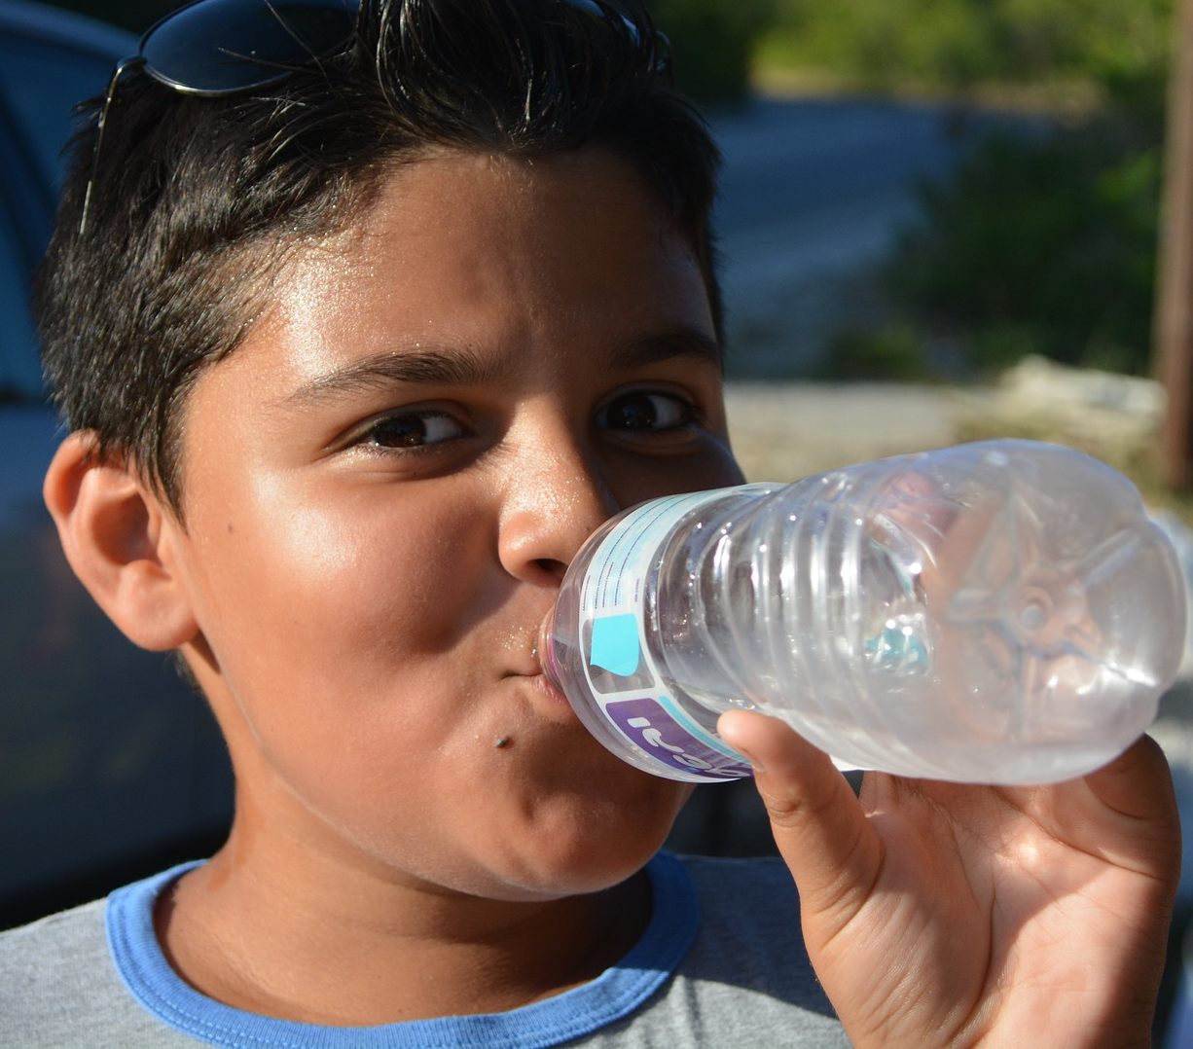


ATTITUDE
Air | Take a few deep breaths
Nutrition | Have you eaten? When did you last eat? What did you eat?
Sunshine | Indoors too much? Outdoors too long?
Water | How much water have you had today?
Exercise | Need a walk? Run? Release some repressed energy? Too much exercise?
Rest | Relax – take 5 minutes to be alone Meditate, breathe, destress How much sleep did you get last night? Have you been sleeping deeply? Are you due for a holiday?
Got a problem?
Check how you are going
with each of these
healthcare practices.
You may find the ANSWER!

