Slide 1

STUDENT
Health Survey

Slide 2
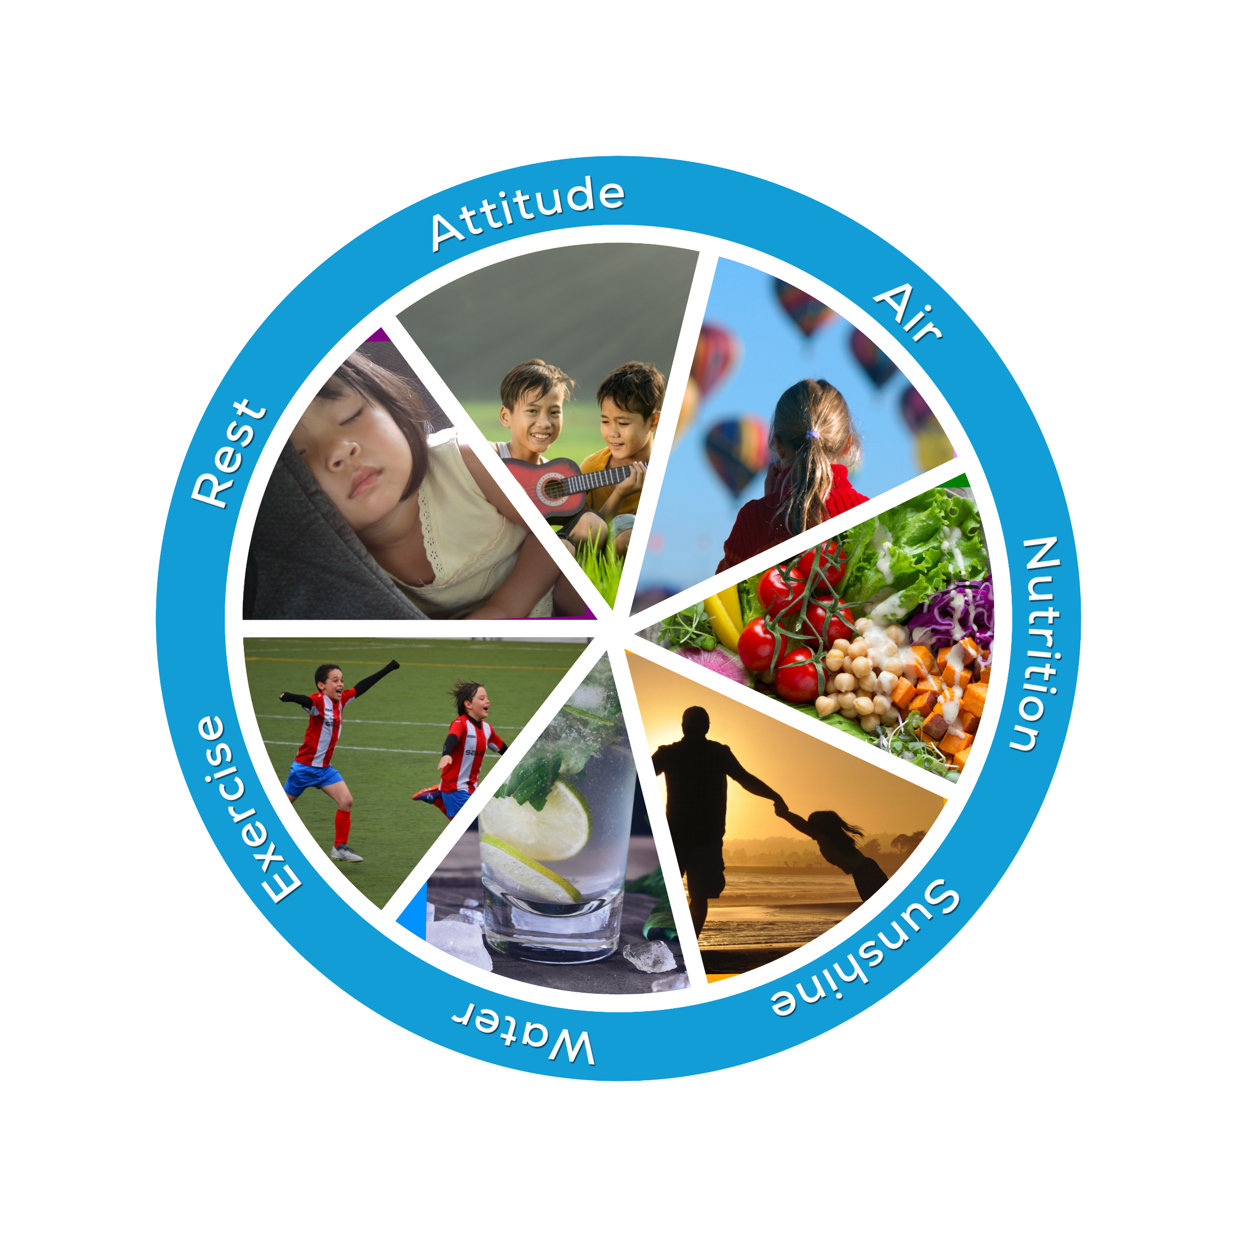
Welcome to the It Takes 7 Health Survey!

Slide 3
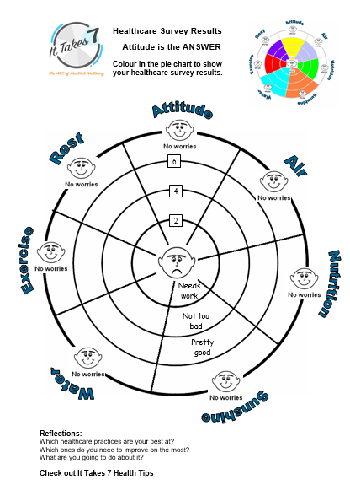

1. Print a copy of the Health Survey Results Sheet before you start the survey.
2. Answer the health survey questions on the following slides. Tally your results and colour in the sections on your Health Survey Results sheet to match your score. Each section in the slice is worth 2 points.

Slide 4

ATTITUDE
Do you feel happy?
Do you get on well with your family and friends?
Do you find it easy to forgive others?
Are you grateful for the good things you have?
Not really = 0 Sometimes = 1 Most of the time = 2

Slide 5
AIR
Do you breathe through your nose?
Do you breathe to calm your emotions?
Do you sit up and stand up straight?
Do you go outside and enjoy fresh air daily?
Not really = 0 Sometimes = 1 Most of the time = 2

Slide 6
NUTRITION
Do you eat at least 2 fruit and 5 vegetables each day?
Do you eat protein with each meal?
(meats, fish, dairy, nuts or legumes)
3. Do you eat only one sweet treat each day?
4. Do you chew your food slowly and with thanks?
Not really = 0 Sometimes = 1 Most of the time = 2

Slide 7
SUNSHINE
In summer do you practice SunSmart rules?
(hat, sunscreen, protective clothing, sunglasses, water)
2. Do you cover up during the middle of the day (10am-3pm)?
3. Do you spend time outdoors during sun safe times?
(early in the morning or late afternoon)
4. In winter do you get enough exposure to the sun?
Not really = 0 Sometimes = 1 Most of the time = 2

Slide 8
WATER
Do you drink water regularly throughout the day?
2. Do you drink about 6 cups of water daily?
3. Do you drink more water if it is hot or when you are exercising?
4. Do you dilute sweet drinks with water?
Not really = 0 Sometimes = 1 Most of the time = 2

Slide 9
EXERCISE
Do you exercise regularly?
Do you walk or ride instead of going in a car or public transport?
Do you play team sports?
On your holidays do you do lots of physical activities?
(hiking, swimming, cycling, paddling, etc)
Not really = 0 Sometimes = 1 Most of the time = 2

Slide 10
REST
Do you sleep for around 10 hours each night?
Do you engage in activities that help you relax? (hobbies, swimming, playing with pets, gardening, etc)
Is your room quiet and dark?
Do you avoid using technology in bed at night?
Not really = 0 Sometimes = 1 Most of the time = 2

Slide 11
Great!
You are now ready to review your results.
Go back to the website and do Lesson 3c.

Slide 12
Well done!

